Slide 1
GcilA Conference on May 20th –FNTP headquarters Global Construction Contracts and PPP in their Infancy The North American Situation, a Promising Market for European Companies Setting the global P3 scene
Marc Frilet
Managing Partner “Frilet - Société d’Avocats”
Chair of the Management Committee of GcilA
Vice-president of the French Institute of International Legal Experts (IFEJI)
Head of the drafting committee IFEJI CICA PPP – Working Group
Co-promoter of UNECE PPP International Center of Excellence
Fellow American College of Construction Lawyers

Slide 2
Efficient private participation in delivery of public infrastructure services: a new condition of sustainable economic development virtually anywhere in the world
Private delivery of public infrastructure services is now recognized as a condition of sustainable economic development virtually anywhere in the world.
Two main reasons:
The last financial crisis has confirmed that in most countries public budget will not have the capacity to bridge the infrastructure financing gap.
In the few countries which could afford to finance from public budget, it is recognized that the private sector capacity to design, build and operate essential public infrastructure services leads generally to better value for money.
Without it?
The development world will have no chance to meet the UN sustainable development goals
Many developed countries will lose percentage point of GDP: In this respect the North American situation is a most interesting case

Slide 3
The global P3 market is in danger
Lack of confidence in P3 is growing in most countries.
Developing countries: in spite of huge efforts from the international community, the situation is most alarming:
Average rate of projects in distress: more than 50% after 2 years for contracts concluded often for decades.
Many good potential projects never put to tender.
Developed countries:
Recent PPP delivery forms under any criticism: UK and to a lesser extent France
This situation is a serious danger for developing global P3 market

Slide 4
A promising future for P3 if lessons learnt in the world are well aggregated and disseminated
Recent convergence between working group of P3 practitioners and governments representatives from most developing countries: G20 conclusion in Cannes; UNCITRAL WG, TOS PPP, IFEJI, CICA and several joint seminars and workshops within public and private sector in Africa, Asia, etc.
Conditions of success of P3 are very similar for most P3 projects irrespective of sectors and countries.
Conditions of success for a particular project in a particular country is going much beyond fresh regulation on projects procurement and creation of PPP units.
As well noted by the PPIAF and World Bank, many of the conditions of success remain to be better identified then designed and formulated by authoritative bodies.

Slide 5
A promising future for P3 if lessons learnt in the world are well aggregated and disseminated (2)
P3 have many characteristics unknown in most transactions leading to the existence of a chain of conditions all essentials for delivering pipelines of resilient PPP projects
Institutional setup at central and local level able to address the range of practical economic, social, legal and regulatory issues.
Complex methodology for:
Planning and prioritization of projects involving political decisions
Assessing needs: scope of service, costs, income stream
Identifying the project externalities
Safeguarding of public interests over the project recovery time: often decades
Safeguarding legitimate private interests over the life of the venture
Safeguarding stakeholders interests

Slide 6
A promising future for P3 if lessons learnt in the world are well aggregated and disseminated (3)
Acceptance by both parties of template clauses which are the essence of partnership unusual in most traditional contracts: examples:
Sovereign interference:
Change of scope of service
Tariff setting
Early termination
Special compensation rights
Contract monitoring
Dispute avoidance and alternative dispute resolution mechanisms

Slide 7
P3 lessons learnt in Africa and Asia
List of the main practical issues to address together for developing pipelines of Projects for essential Public infrastructure services
1. PPP preparation
2. PPP procurement
3. PPP contract conditions
Planning and prioritization
Socio-economic order of magnitude
Prefeasibility
Comprehensive eco-fin.
scenario
Decision to tender
Main procurement processes
Pre-selection
Pre-qualification
RFP
Outcome oriented
Misprocurement
Final selection
Source: CICA IFEJI PPP WG (tested in several workshop with over 40 countries represented)
Construction conditions
Business case reference
Operation and public service obligations
Changing conditions and Regulation
Partnering
ADR

Slide 8
P3 lessons learnt in Africa and Asia
List of the main practical issues to address together for developing pipelines of Projects for essential Public infrastructure services
4. PPP underlying principles
5. Central level institutions
6. Project level institutions
Investment Climate
Public service priority
Particular rights of the Public Authority
Particular rights of project company
Economic equilibrium and Regulation
Planning and prioritization agency or department
PPP
Promotion agency or department
Project evaluation and monitoring agency or department
Choice of outside advisers
Governance Integrity
Efficiency
Source: CICA IFEJI PPP WG (tested in several workshop with over 40 countries represented)
Governance Integrity
Efficiency
Planning and prioritization agency or department
Procurement
committee
Monitoring
committee
Choice of outside advisers

Slide 9
How to aggregate lessons learnt internationally and locally for delivering pipelines of successful P3
An innovative and inclusive approach not developed so far is imperative to formulate best practices and promote templates and standards.
It is now recognized that this approach could lead to comprehensive and simple framework laws and standard documents and procedures simplifying the process which are the main condition for effective implementation of pipelines of P3 in most countries,
This new “leapfrog” approach has been progressively designed after several years of exchanges between international public and private experts
The CICA / IFEJI working group
The UNECE International Center of Excellence “policies, laws and institutions“
The UNCITRAL Model law project

Slide 10
Underlying clarification on PPP delivery form and their importance
PPIS illustrative chart
PPIS definition
Current number and size of PPIS

Slide 11
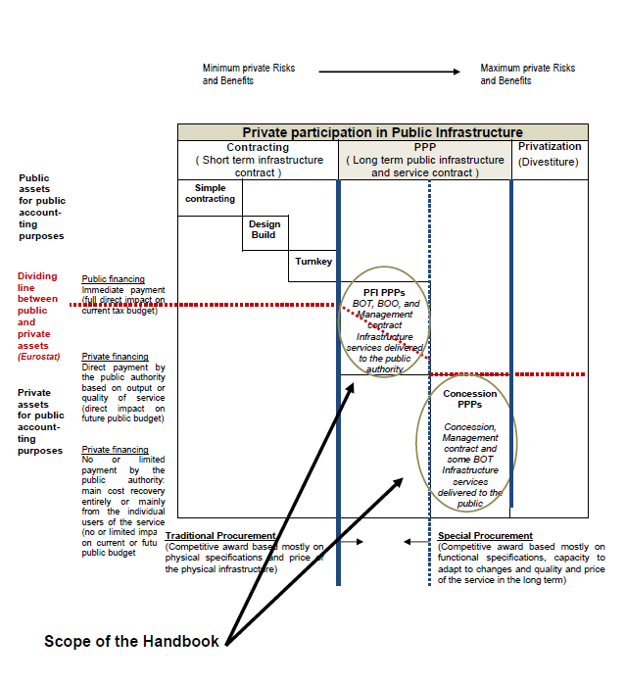
PPP illustrative chart
Two families of PPP

Slide 12
The two main families of PPP
1. PFI / PPP FAMILY | 2. CONCESSIONS / PPP FAMILY
Design (based on functional specifications) Build or rehabilitate Finance
Maintain and/or Operate the infrastructure or utility without delivering the full public service | Operate the infrastructure or utility with obligation to deliver full public service to the end users
Compensated entirely by the public authority when service is available or rendered | Compensated entirely or mainly by the end users paying for the service
Contract duration limited to the project cycle (amortization of assets, profit marging and financial recovery)

Slide 13
The size of the two families of PPP
Most common Concessions PPP:
Water and wastewater
Urban services
Garbage collection
Social and recreation public services
Railways
Ports
Airports
Toll highways
Toll Bridges
Toll tunnels
Most common PFI/PPP:
Hospitals
Prisons
Schools
Public lightening
Power production
Water production
Railways

Slide 14
The competitive edge of French companies in the global PPP market
This competitive edge is based on two pillars:
Unique experience in global contracts:
French tradition of contrat d’entreprise and general contractor
Extensive contract liabilities under French law leading to a strong level of integration of different skills: design, engineering, control, planning, construction, service, etc.
Unique experience in public service delivery:
A tradition of integrated approach from including design, construction and service delivery under one hat
Capacity to innovate and adapt for optimizing the service. This natural trend is essential for a resilient partnership with the public sector

Slide 15
Thank You !
Me Marc Frilet
Frilet – Law firm/ GcilA
91, rue du Faubourg Saint Honoré
75008 Paris – France
Tel : + 33 1 56 26 00 40
e-mail : avocats@frilet.com
www.gcila.org
15

